Slide 1


Ship Motion Control and Models (Module 9)
Dr Tristan Perez
Centre for Complex Dynamic Systems and Control (CDSC)
Prof. Thor I Fossen
Department of Engineering Cybernetics

Slide 2
Guidance, Navigation and Control (GNC)

Slide 3
Guidance, Navigation and Motion Control
Guidance: is the action or the system that continuously computes the reference (desired) position, velocity and acceleration of a vessel to be used by the control system. These data are usually provided to the human operator and the navigation system.
Navigation is derived from the Latin navis, "ship," and agere, "to drive." It originally denoted the art of ship driving, including steering and setting the sails. This includes planning and execution of safe, timely, and economical operation of ships, underwater vehicles, aircraft, and spacecraft.
Control: is the action of determining the necessary control forces and moments to be provided by the vessel in order to satisfy a certain control objective.

Slide 4
Guidance system
Generates the desired trajectories (position, velocity and acceleration).
The waypoint generator establishes the desired wayponits according to mission, operator decision, weather, fleet operations, amount of power available etc.
The waypoint management system updates the active waypoint based on the current position of the ship.
The reference computing algorithms generate a smooth feasible trajectory based on a reference model, the ship actual position, amount of power available, and the active way point.

Slide 5
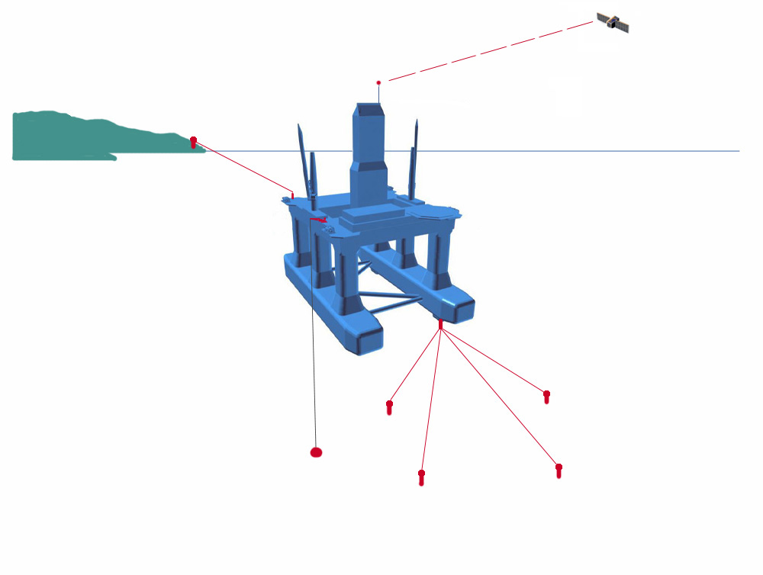
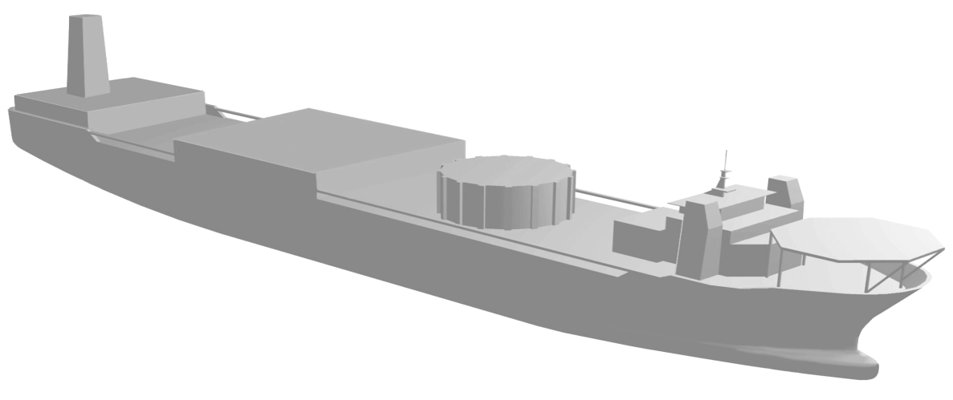

Navigation System
Generates appropriate feedback signals
Sensors Satellite navigation systems, GPS, radar, gyros, accelerometers, compass, HPR, etc.
Signal quality checking Statistic analysis, fault detection, voting, data fusion.
Reference frame transformation translate the motion to that of the origin of the adopted reference frame.
SATELLITE
NAVIGATION
SYSTEM
(DGPS / GLONAS)
SURFACE
REFERENCE
SYSTEM
TAUT
WIRE
HYDROACOUSTIC
POSITIONING
SYSTEM
VRU
GPS ANTENNA
HPR TRANSDUCER

Slide 6
Set-point Regulation, Trajectory Tracking Control or Path Following Control?
Set-Point Regulation: The most basic guidance system is a constant input (set-point) provided by a human operator. The corresponding controller will then be a regulator. Examples of set-point regulation are constant depth, trim, heel and speed control, etc.
Trajectory Tracking Control: The objective is for the position and velocity of the vessel to track given desired time-varying position and velocity reference signals. The corresponding feedback controller must then be a trajectory tracking controller. Tracking control can be used for course-changing maneuvers, speed changing, attitude control, etc. An advanced guidance system computes optimal time-varying trajectories from a dynamic model and a predefined control objective. If a constant set-point is used as input to a low-pass filter (reference model) the outputs of the filter will be smooth time-varying reference trajectories for position, velocity and acceleration (PVA).
Path Following Control: Follow a path in 3D independent of time (geometric assignment). In addition, a dynamic assignment (speed/acceleration) along the path can be assigned. The corresponding controller is a path following/maneuvering controller.

Slide 7
Ship Motion Control
The task of a ship motion control system consists of making the ship to track/follow a desired trajectory or path. Sometimes this also includes motion damping.
In most ship operational conditions, the desired trajectory is slowly varying motion (LF motion) compared to the oscillatory motion induced by the waves (WF motion).
=
+
Slowly varying motion
(due to 2nd Wave loads, current, wind)
Total motion
Oscillatory motion
(due to 1st order Wave induced loads)

Slide 8
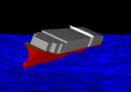
Ship Motion Control Objectives
Due to the motion of ships, motion control problems can have different objectives:
Control only the LF motions (Autopilots, Dynamic Positioning (DP), Position mooring systems)
Control only the WF motions (Heave, roll and pitch stabilisation, ride control)
Control both (DP with roll and pitch stabilisation in high seas, course keeping and roll stabilisation)
Dynamic Positioning
Autopilot
Roll stabilisation

Slide 9
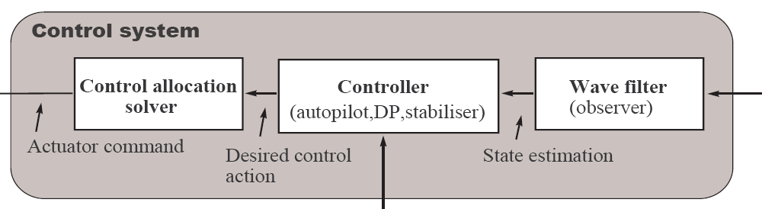
Plant Control System
Generates appropriate actuator commands.
Wave filter (observer): Recover slowly varying motion signals from the total measurements
Controller: Generates force commands (desired control action)
Control allocation: Translate force commands into actuator commands (RPM, PWR, Torque).

Slide 10
Wave Filtering
Removes first order (oscillatory) wave-induced motion
Example course autopilot wave filtering Perez (2005):
Heading angle
Heading rate
Rudder angle

Slide 11
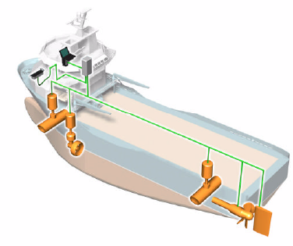
Control Allocation
Some marine control systems are over-actuated to guarantee reliability and high performance – optimization problem
Force and moments
Actuator command
Control demand
Actual control action

Slide 12
Marine Control Problems and Models

Slide 13
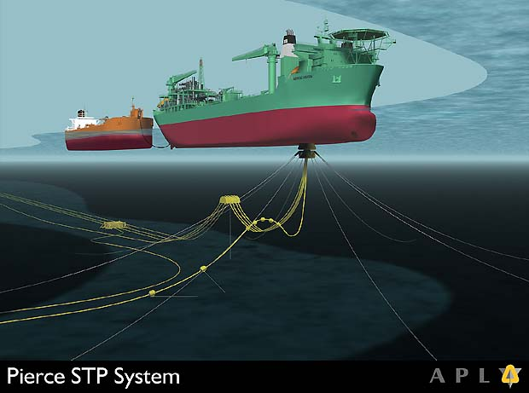
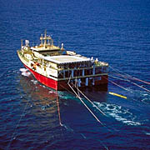
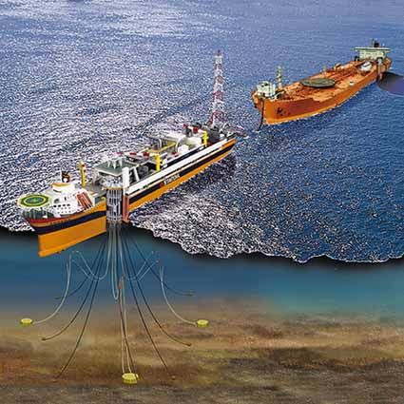
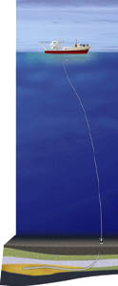
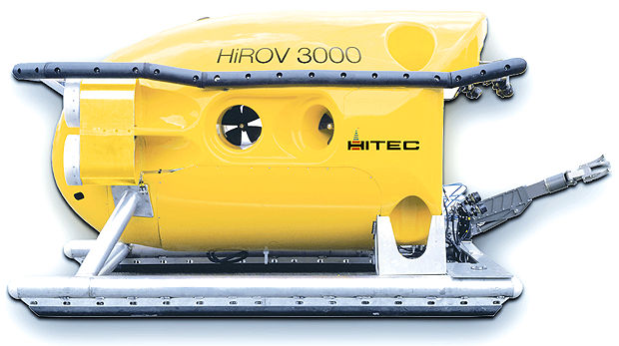
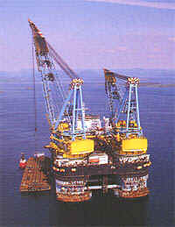
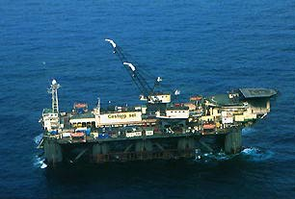
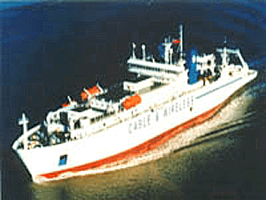
Pipe and cable
laying
Position
mooring
Geological
survey
Heavy lift
operations
ROV operations
Cable laying
vessel
Vibration
control
of marine
risers
Pipe laying vessel

Slide 14
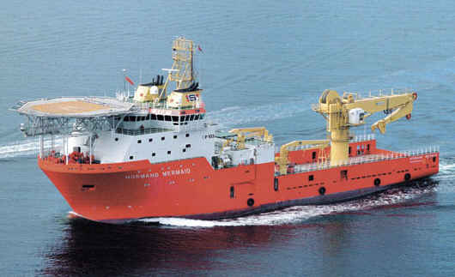
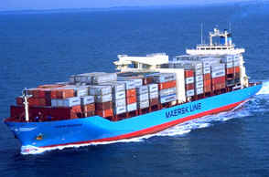
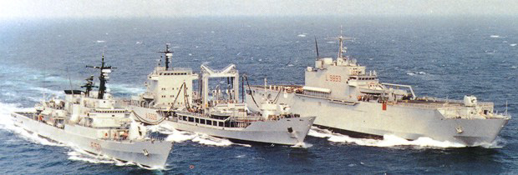
Trajectory Tracking & Maneuvering Control
Fully actuated supply ship cruising at low speed.
Underactuated container ship in transit.
Italian supply ship Vesuvio refueling two ships at sea.
Courtesy: Hepburn Eng. Inc.

Slide 15
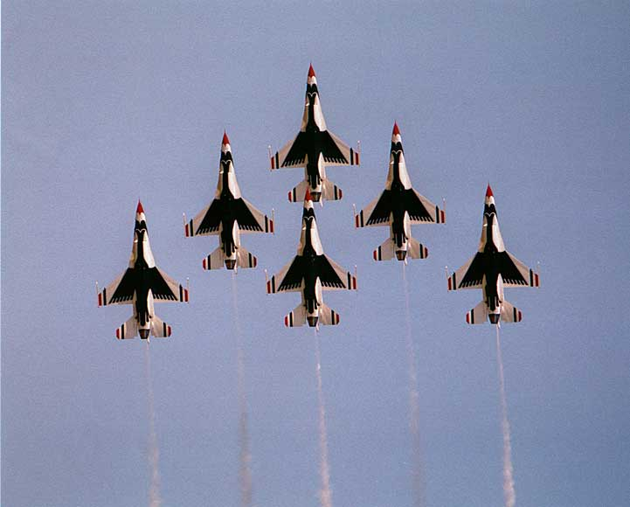
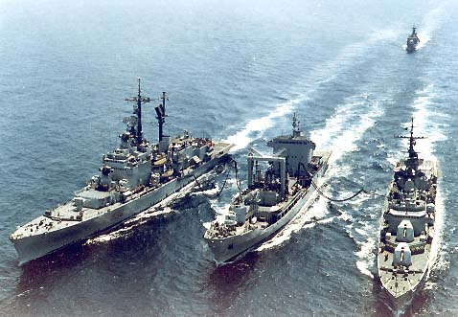

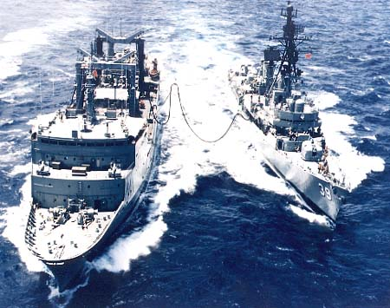
Formation Control/Underway Replenishment
One-day Tutorial, CAMS'07, Bol, Croatia
15
Notes:
Exploit aerodynamic phenomena. Reduction of power demand. V-formation – Geese.
Safety aspects.
Underway Replenishment Operation

Slide 16
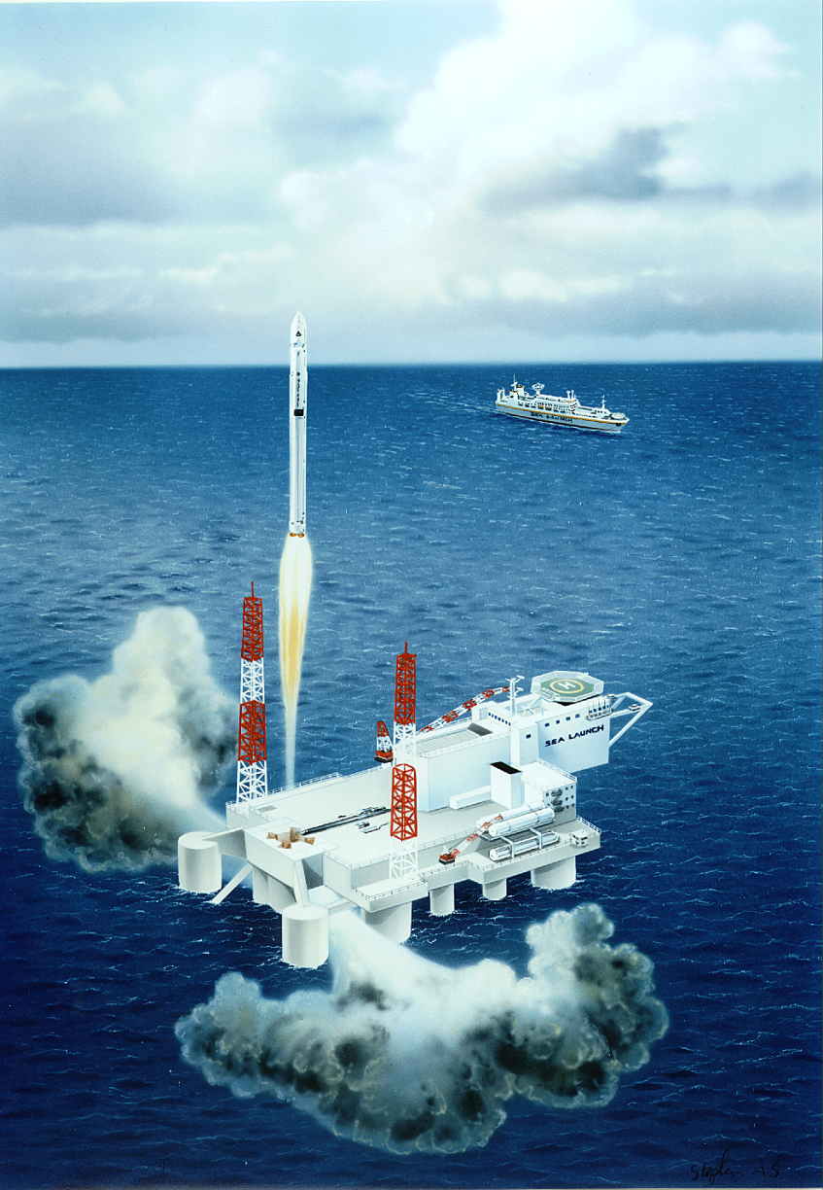
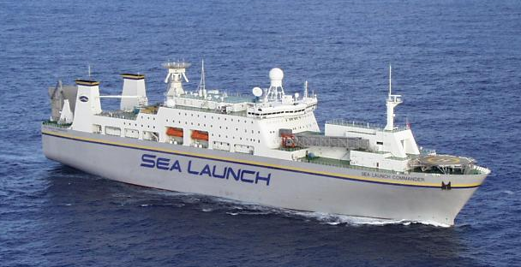
Interdisciplinary: Rocket Launch / DP system / THCS
Launch Platform
Assembly Command Ship

Slide 17
Trim & Heel Correction System (THCS)
Process Control
or
Marine Control?

Slide 18
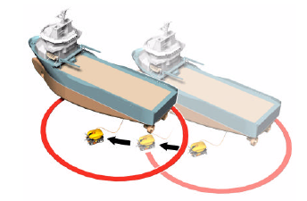
Dynamic Positioning
Drilling vessel (Regulation)
ROV operations (tracking)
Control objective: Keep position; follow slow changes in set point.
DOF: 1,2,6 (surge, sway and yaw) [pitch and roll can be incorporated in high sea states in offshore rigs]
Model: time-domain model which includes cross-flow drag effects. The Munk moment, which is in the added mass Coriollis-centripetal terms should be added. Alternatively, use current coefficients (experimental data).
Disturbances: Wind, current, mean wave drift and slowly varying wave forces.

Slide 19
Course and Heading Autopilots
Heading
Course keeping
Control Objective: Keep heading or course. For course keeping autopilots, positioning control and guidance systems must also be designed (outer loop).
DOF: 2,[4], 6 (sway, roll, yaw) There is strong coupling between sway and yaw which is not convenient to ignore, and roll also affect these modes.
Model: Manoeuvring model; at high speed lift-drag effects are significant. The model can be linearised for control design because the must operate close to equilibrium conditions.
Disturbances: Wind, waves (there must be a wave filter); for a course keeping autopilot, current is also a disturbance.

Slide 20
Manoeuvring Control
Control objective: geometric and dynamic conditions for path following, way-point or trajectory tracking.
DOF: 1,2,[4],6.
Model: nonlinear manoeuvring model.
Disturbances: wind, waves, current.

Slide 21
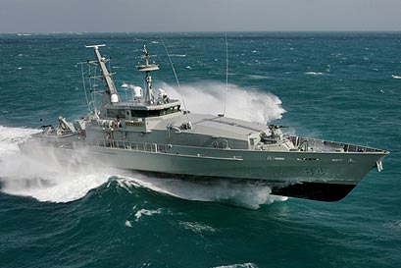
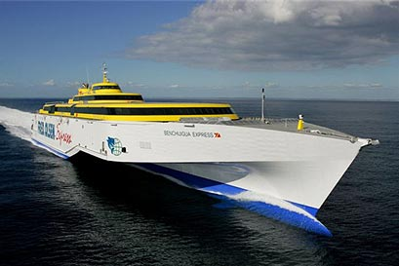
Ride Control
Control objectives: reduce roll and pitch.
DOF: 4,5.
Model: linear time-domain model, with viscous corrections for roll.
Disturbances: 1st order wave induced motion; wind, trim variations with speed.

Slide 22
Heave Compensation
Control objective: reduce the effect of heave motion in different components of the system.
DOF: 3,[5].
Model: linear time-domain model + nonlinear viscous effects and structural stiffness.
Disturbances: 1st order wave-induced motion, and rapidly-varying 2nd order wave-induced motions

Slide 23
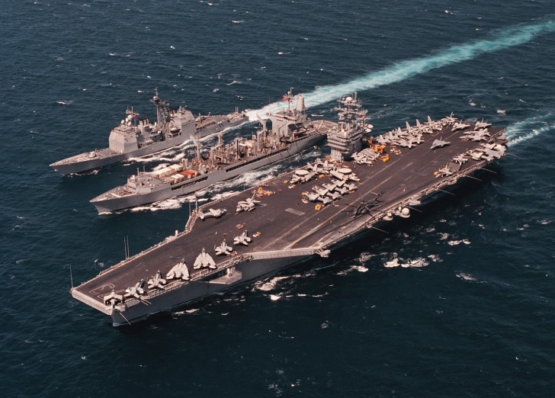

Ship-to-Ship Operations
Control objective: keep formation.
DOF: 1,2,6.
Model: time-domain model with ship-to-ship hydrodynamic interaction if vessels are too close.
Disturbances: waves, wind, current

Slide 24
Modelling Disturbances for Control Design
If a model-based control design requires disturbance modelling,
Waves:
1^{st-}order wave loads (due to wave spectrum) can be modelled using multi-sinces with random phases or filtered white noise (wave spectrum).
Mean wave drift loads can be modelled as a 1^{st-}order Wiener process (1st-order system driven by white noise.)
Currents:
Current loads can be included using the concept of relative velocity in surge, sway and yaw (in DP current coefficients can also be used)
Wind:
Wind loads are included using wind coefficient tables.

Slide 25
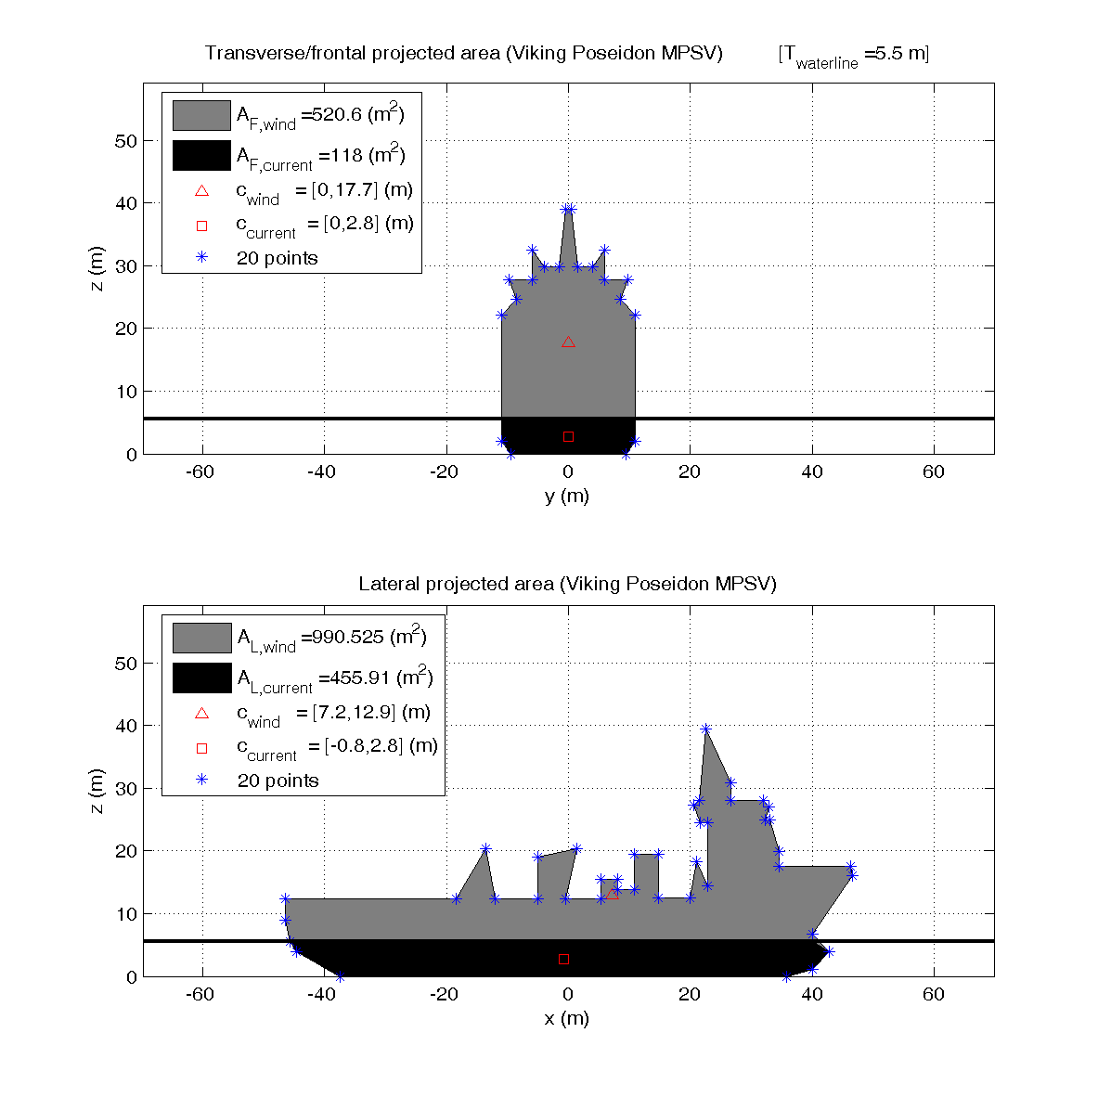
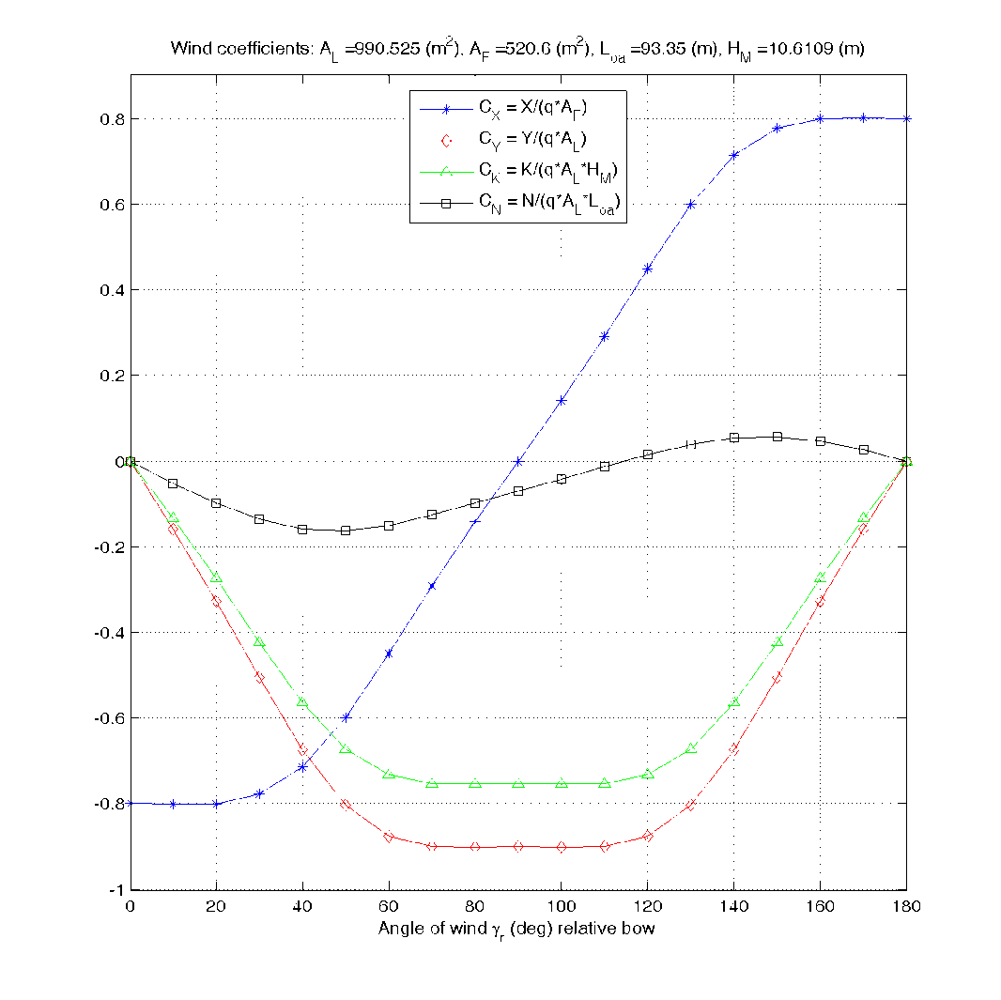
Wind Loads
Wind areas and centroids from digitized GA
For best results experimental data from wind tunnels should be used.

Slide 26
Example: Simulation of Wave Loads in DP
Modelled as filtered white noise
Modelled as a Wiener process
For position mooring we need to add the restoring forces due to the mooring lines
Osclillatory wave-induced motion
total motion
GNC
Guidance Navigation Control
Measurement noise
Modelled as Gaussian white noise
This model is typically used to design control and observers.

Slide 27
Useful References
Fossen, T. I. (1994). Guidance and Control of Ocean Vehicles, John Wiley
Fossen, T.I. (2002). Marine Control Systems. Marine Cybernetics.
Perez, T. (2005). Ship Motion Control. Springer Verlag.
Sørensen, A.J. (2005). “Marine Cybernetics”. Lecture Notes Dept. of Marine Technology, NTNU, Norway

